Slide 1
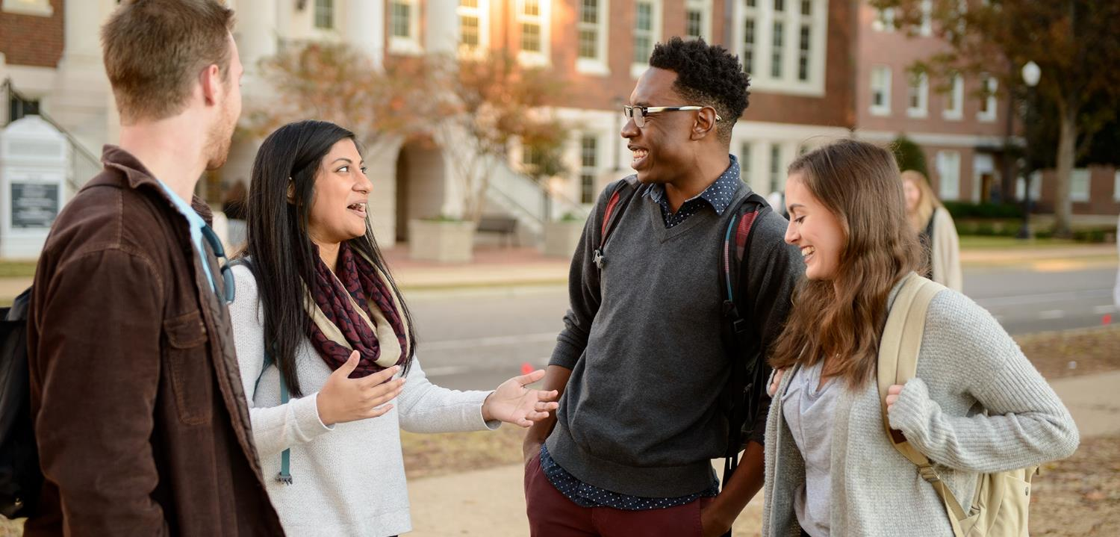

HR TRANSFORMATION INITIATIVE
Town Hall Forum
March 12, 2020

Slide 2

HR Transformation Team Members
Matt Fajack (Project Sponsor) Vice President for Finance & Operations | Kay Palan (Team Leader) Dean, Culverhouse College of Business
Linda Bonnin Vice President for Strategic Communications | Melanie Danner Director of Financial Affairs, College of Communication & Information Sciences, Dean's Office
Rona Donahoe Professor, Geological Sciences | Allison Drake Executive Director of Advancement Operations
Jonathan Halbesleben Dean, College of Continuing Studies | Darrell Hargreaves Associate Director, Facility Operations and Events
Laverne Harris Associate Vice President, Finance and Operations Shared Administrative Services | Steven Hood Associate VP for Student Life
Allison Jeffreys Assistant Athletics Director, Human Resources | Jordan Johnson Business Administrator, Academic Affairs
James King, Jr. Professor, Culverhouse College of Business | John McGowan Vice Provost of Information Technology & CIO
Russell J. Mumper Vice President for Research and Economic Development | Angel Narvaez – Lugo Program Assistant, Fraternity & Sorority Life
Travis Railsback Director, Human Resources | Lisa Rhiney Associate Provost
Christine Taylor Vice President, Office of Diversity | Chad Tindol Chief Administrative Officer
Jimmy Vail Director of Financial Affairs, College of Arts & Sciences | Rainey Way Process Improvement Specialist
Monica Watts Associate Vice President for Communications | Nancy Whittaker Associate Vice President for Human Resources

Slide 3
Why Does UA need an HR Transformation?
STRUCTURE
TALENT
PROCESSES, POLICIES & TECHNOLOGY
CULTURE
Address the risks and challenges of a decentralized HR function
Provide campus stakeholders with better access to HR professionals
Provide more strategic HR services
Address existing confusion between AA and HR roles and services
Enhance the University’s ability to attract and retain talent
Better educate, develop and support employees at all levels
Position HR to support and accommodate growth of the University
Enhance the skills and competencies among HR professionals
Reduce administrative burdens on faculty
Improve efficiencies and reduce HR timelines
Gain consistency in HR policies and services
Improve core HR processes and systems (e.g., the performance evaluation process)
Leverage technology to enhance HR services
Elevate levels of employee engagement and morale across campus
Improve the overall work experience at UA better
Align UA with HR leading practices

Slide 4
Project Timeline
Phase 1 and Phase 2 Detailed Timeline
Understand Key Components of HR Assessment
Design HR Model for The Future
Redesign HR Roles, Structures, and Functions
HR Governance, Communication, Culture, Processes and Technology
Review outcomes from organizational assessment
Conduct SWOT analysis of HR structures, services, processes, and competencies
Leverage findings to develop recommendations for future state HR organization
Develop detailed roadmap for transforming HR organization
Design a new and improved HR model that provides for enhanced offerings, including strategic recruitment and retention, strategic compensation and benefits, and learning and development
Create detailed plans to support and implement model that address new structures, roles, services, processes, technology, and culture
Establish timelines, milestones, and implementation plans
Review and revise HR governance structure
Establish communication strategy for varying levels and importance of HR communications
Identify change management strategy
Phase 1
Phase 2
September 2019 – January 2020
February 2020 – May 2020

Slide 5
A Reimagined Model for Delivering HR Services
CENTRAL HR
Establishes University-wide employment policies and standards, and guides HR strategies on behalf of the campus
Supports a network of HR Business Partners and the University community through a set of Centers of Excellence delivering core HR services in areas such as Compensation, Benefits, Professional Development, and Employee Relations
HR BUSINESS PARTNERS
Provides HR and employment counsel and advice to divisional, unit, and department leaders
Assigned or aligned by major Division, or shared across smaller units as appropriate
Administers and executes HR and employment policies, practices, and standards established by Central HR
Provides a wide range of consultative HR and employment services across the Division or unit

Slide 6
A Reimagined Model for Delivering HR Services
COLLEGES, SCHOOLS, DIVISIONS, UNITS
Responsible for making all critical employment-related decisions, including decisions related to hiring, performance evaluation, promotion, development, and compensation for unit-based faculty and staff
Responsible for establishing and administering staffing levels, assigning roles and responsibilities providing supervision, and all other elements involving the day-to-day employment matters involving faculty and staff in the unit

Slide 7
A Reimagined Model for Delivering HR Services
CENTRAL HR
Establishes campus-wide HR policies
Develops and defines employer brand
Drives strategies for employee engagement & well-being
Establishes compensation philosophy, guidelines, and plan
Monitors pay equity and candidate pool diversity
Develops benefits strategy
Designs recognition strategy and program
Designs training and leadership development programs
Develops onboarding guidelines and facilitates onboarding
Provides strategic recruiting support
Administers central HR Enterprise Systems
Ensures compliance with University, state, and federal laws and regulations
HR BUSINESS PARTNERS
Serves as primary HR point of contact for managers, supervisors, and all other employees within their assigned unit
Applies, implements, and enforces HR and employment-related guidelines and policies
Administers core HR processes outlined by Central HR (i.e., performance management, retirement, employee engagement, etc.)
Guides hiring process and develops job descriptions
Implements diversity and inclusion initiatives at local level
Gathers feedback and communicates to Central HR
Sets salaries within University guidelines
Understands, communicates, and promotes recognition programs and coordinates rewards
Identifies training needs and creates unit-specific training programs
Coordinates and oversees departmental onboarding

Slide 8
A Reimagined Model for Delivering HR Services
COLLEGES, SCHOOLS, DIVISIONS, UNITS
Identifies staff and faculty hiring needs
Interviews and selects candidates
Sets performance goals for faculty and staff
Provides budget and financial support for faculty and staff
Identifies staff and faculty for promotional opportunities
Establishes roles and responsibilities for staff and faculty
Identifies unit-based training needs
Develops staffing levels
Works with HRBP and Central HR to address employee relations matters
Manages, supervises, and assigns faculty and staff as needed

Slide 9

Human Resources
Centers of Excellence
Talent Acquisition & Compensation
HR Service Center
Benefits
Payroll
Learning and Development
Employee
Relations
Human Resources Business Partners

Slide 10
HR Transformation Next Steps
Finalize the HR model
  Determine distribution and number of HR Business Partners
  Design Centers of Excellence
Solicit campus stakeholder perspectives about the future of HR
  Town Hall Comments
  HReimagined Website
Develop detailed design elements to support HR Transformation
  Redesign roles, responsibilities, accountabilities, and functions
  Review and revise core HR processes and technology
  Develop implementation approach and strategy

Slide 11

Questions?

Slide 12
Share your thoughts and Ideas
What will be different about central HR in the new model?
How many HR Business Partners will there be?
Where will the HR Business Partners report to?
Why will this model be better for staff and faculty?
When will these changes occur?

